Slide 1
Negotiable Instruments Act, 1881
Comparison among Bill of exchange, promissory note and cheque
Ms Meenakshi
Assistant Professor
Commerce Department
Kanya Mahavidyalaya Kharkhoda

Slide 2
Meaning of Negotiable Instrument
‘Negotiable’ means transferable by delivery and ‘Instrument’ is a written document which creates a right in favour of any person.
Therefore, a negotiable instrument is a written document which creates a right in favour of any person and which is transferable by delivery.
As per section 13 of negotiable instrument act 1881 , bill of exchange, promissory note and cheque payable either to order or to bearer are negotiable instruments.

Slide 3
Bill of exchange
“ A bill of exchange is an instrument in writing, containing an unconditional order signed by the maker directing a certain person to pay a certain sum of money only to , or to the order of , a certain person or to the bearer of the instrument.”
---Negotiable Instrument Act 1881

Slide 4
Characteristics of Bill of Exchange
Written
Unconditional
Order letter
Signature of the drawer
Fixed amount
Payable to a specified person or to the order of a specified person or to the bearer
Payable on demand or after specified duration
Stamped according to its value
Value received
Parties-Drawer , Drawee and payee

Slide 5
Specimen of Bill of Exchange
Rs.5000 New Delhi
May 18, 2020
Two months after date pay to me or my order the sum of Rs. Five thousand, for value received.
Dev kumar
Sh. Keshav lal
280,kamla nagar
Ghaziabad, Uttar Pradesh
STAMP

Slide 6
Promissory Note
“A promissory note is an instrument in writing (not being a bank note or currency note) containing an unconditional undertaking signed by the maker, to pay a certain sum of money to, or to the order of a certain person.”
--- Negotiable Instrument Act 1881

Slide 7
Characteristics of Promissory Note
Written
Unconditional
Signed by the debtor
Payable to a specified person or to the order of a specified person or to the bearer
Payable after specified duration
Stamped according to its value
Fixed amount in the currency of country
Value received
Date and Place of making the promissory note need not be mentioned on it.

Slide 8
Specimen of Promissory Note
Rs. 2000 Rohtak
April 10,2020
On demand (or three months after date), I promise to pay Shri Jagmohan or Order the sum of rupees two thousand with interest @10% per annum until payment for value received.
Shri Kanwarpal
Signature
STAMP

Slide 9
Cheque
“A cheque is a bill of exchange drawn on a specified banker and not expressed to be payable otherwise than on demand.”
----Negotiable Instrument Act 1881

Slide 10
Features of cheque
Drawn upon a specified banker.
Payable on demand.
Signed by the drawer.
Unconditional order to pay certain amount of money.
Must be dated.
Cheque is crossed to make it secure.
Cheque can be crossed in two ways: general crossing and special crossing.
In general crossing ‘& co.’ ‘ and company’ ‘not negotiable’ words are written between two parallel lines.
In Special crossing, along with above mentioned words , name of any specific bank is also mentioned.

Slide 11
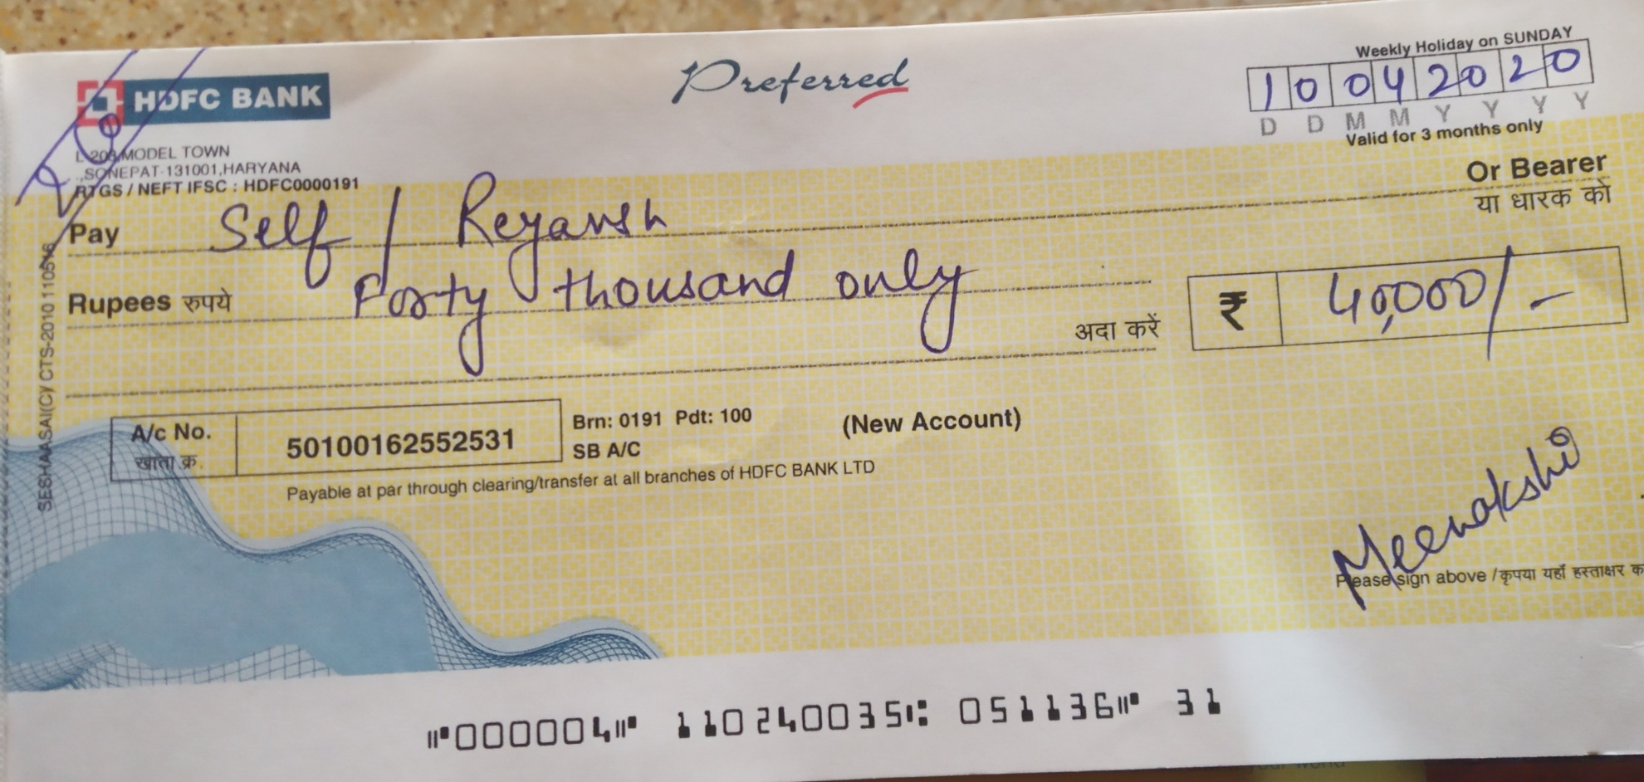
Specimen of a crossed cheque

Slide 12
Comparison
Basis of Difference | cheque | Bill of Exchange | Promissory note
Parties | Drawer (maker or issuer) Payee (receiver) Payer (bank) | Drawer (maker ) Drawee (drawn on any person) Payee (receiver) | Maker payee
Order of payment | Order to pay | Order to pay | Promise to pay
Acceptance | Need not to be accepted | Accepted by the drawee | Need not to be accepted
Period | Payable on demand | Either be a Sight bill or time bill | Either be a Sight bill or time bill
circulation | Within the country | Within and outside the country | Within the country
crossing | Can be crossed | Can not be crossed | Can not be crossed

Slide 13
Comparison continues….
Basis of difference | cheque | Bill of exchange | Promissory note
mistake | In case mistake is made in drawing the cheque, the bank will not make the payment. | In case mistake is made in drawing a bill of exchange and the drawee accepts the same, then he is bound to pay the amount thereof. | In case of a mistake in making a promissory note, the makker continues to be liable thereon.
Liability if not presented in due course | If there is a delay in presenting the cheque the bank will not make payment of the same. | In case there is a delay in presentment of a bill of exchange, all parties other than the drawee are relieved of their liability. | In case there is a delay in presentment of a promissory note, the maker is not relieved of his liability.

Slide 14
Thanks

